Slide 1
The Bitcoin Network and Payments

Slide 2
The Bitcoin network
The Bitcoin network is a peer-to-peer (P2P) network
Nodes perform transactions, verify and propagate transactions and blocks.
Nodes called miners also produce blocks.
The two main types of nodes
Full nodes : are implementations of Bitcoin Core clients performing the wallet, miner, full blockchain storage
simple payment verification (SPV) nodes: lightweight clients perform only wallet and network routing functionality

Slide 3
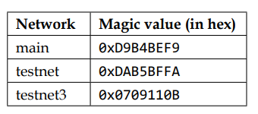
A Bitcoin network is identified by its magic value
the latest version of the Bitcoin protocol is 70015
introduced with Bitcoin Core client 0.19.0.1.

Slide 4
There are 27 types of protocol messages in total
• Version: node sends out to the network, advertising its version and block count
• Verack: This is the response of the version message accepting the connection request
• Inv: This is used by nodes to advertise their knowledge of blocks and transactions
• Getdata: This is a response to inv, requesting a single block or transaction identified by its hash

Slide 5
• Getblocks: This returns an inv packet containing the list of all blocks starting after the last known hash or 500 blocks
• Getheaders: This is used to request block headers in a specified range.
• Tx: This is used to send a transaction as a response to the getdata protocol message.
• Block: This sends a block in response to the getdata protocol message
• Headers: This packet returns up to 2,000 block headers as a reply to the getheaders reques

Slide 6
• Getaddr: This is sent as a request to get information about known peers
• Addr: This provides information about nodes on the network
• Ping: This message is used to confirm if the TCP/IP network connection is active.
• Pong: This message is the response to a ping message confirming that the network connection is live.

Slide 7
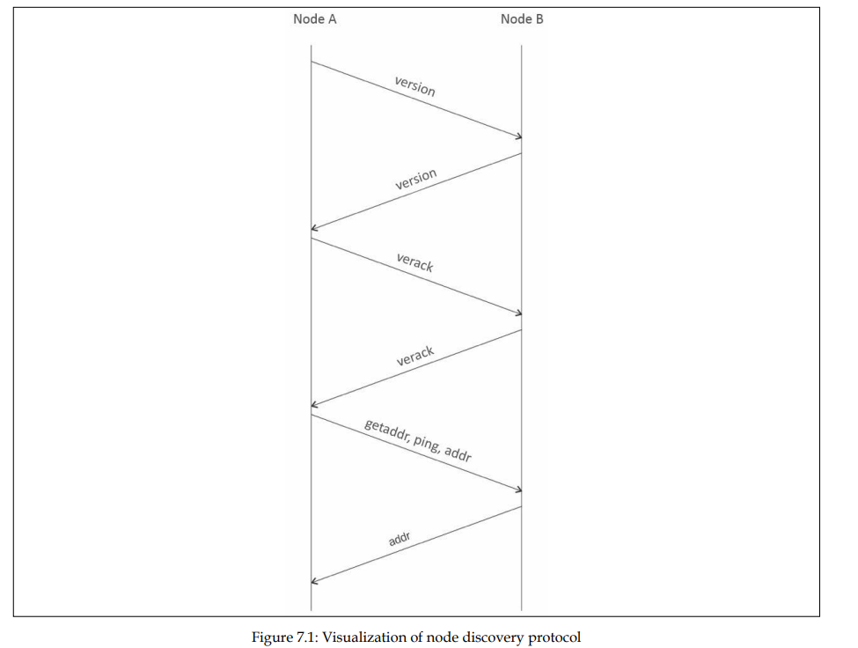
First, Node A starts the connection by sending a version message that contains the version number and current time to the remote peer, Node B
Now, the block download can begin. If the node already has all the blocks fully synchronized, then it listens for new blocks using the inv protocol message; otherwise, it first checks whether it has a response to inv messages and has inventories already. I

Slide 8
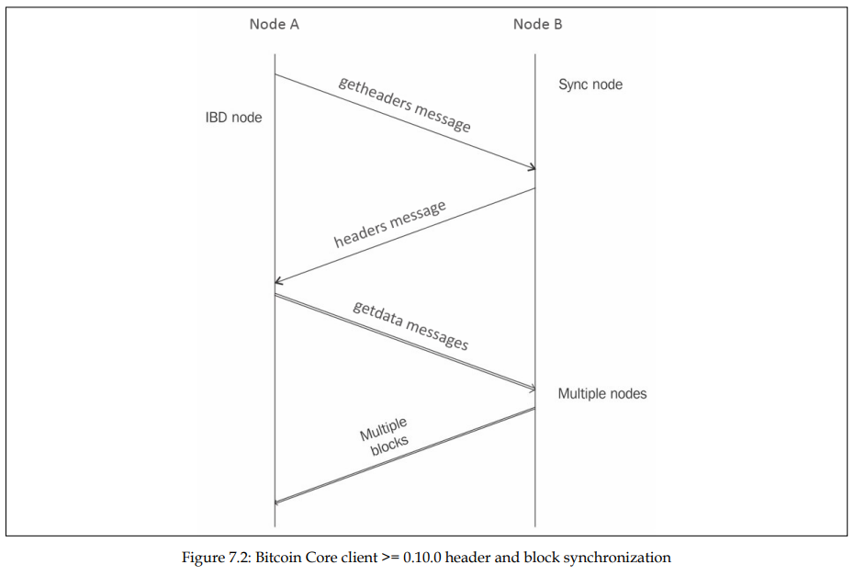
Node A, shown on the left-hand side, is called an Initial Block Download (IBD) node, and Node B, shown on the right, is called a sync node
IBD node means that this is the node that is requesting the blocks, while sync node means the node where the blocks are being requested from.

Slide 9
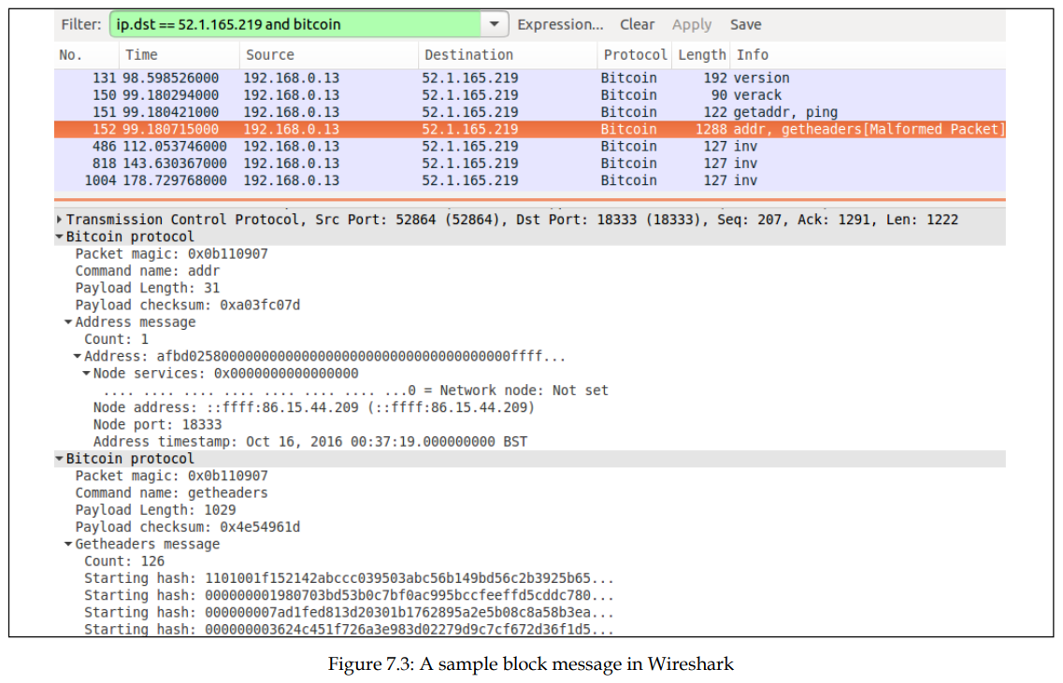
Bitcoin protocol messages in wireshark

Slide 10
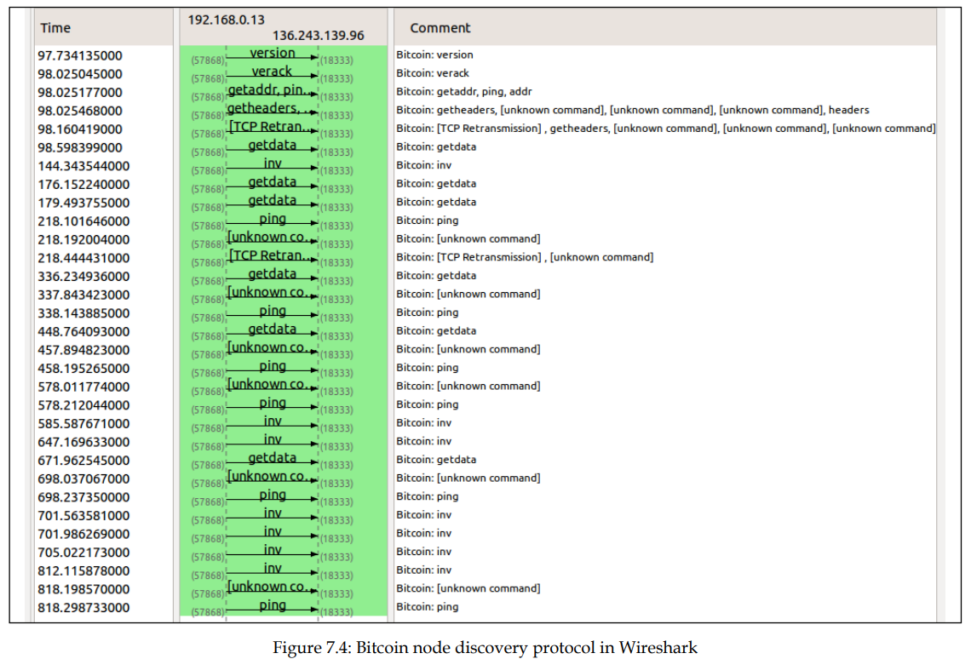
The top three messages show the node discovery protocol

Slide 11
Full client and SPV client
Bitcoin network nodes can operate in two modes:
full client
lightweight SPV client
Full clients are thick clients or full nodes that download the entire blockchain; this is the most secure method of validating the blockchain as a client.
SPV clients are used to verify payments without requiring the download of a full blockchain.
SPV nodes only keep a copy of block headers of the current longest valid blockchain.
Verification is performed by looking at the Merkle branch, which links the transactions to the original block the transaction was accepted

Slide 12

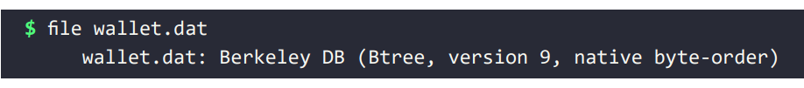
Wallets
The wallet software is used to generate and store cryptographic keys.
Other functions of wallet
receiving and sending Bitcoin
backing up keys
keeping track of the balance available.
On disk, the Bitcoin Core client wallets are stored as a Berkeley DB file:

Slide 13
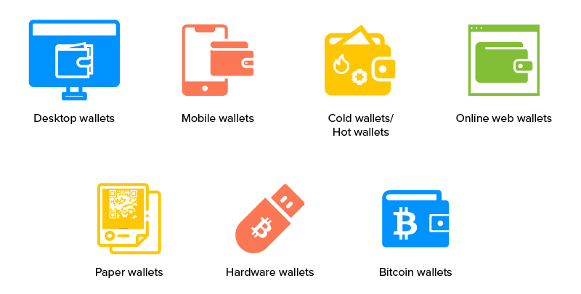
Wallets
Private keys are generated by randomly by the wallet
Private keys are used by wallets to sign the outgoing transactions.
Wallets do not store any coins,
In the bitcoin network, coins do not exist
Only transaction information is stored on the blockchain (more precisely, UTXO, unspent outputs)
Which are then used to calculate the number of bitcoins.

Slide 14
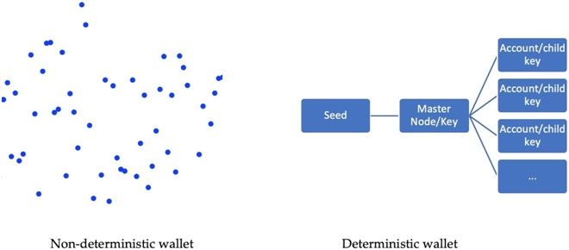
Types of wallets
Non-deterministic wallets
wallets contain randomly generated private keys and are also called Just a Bunch of Key wallets.
The Bitcoin Core client generates some keys when first started and also generates keys as and when required
large number of keys is very difficult and an error-prone process
Deterministic wallets
keys are derived from a random seed value via hash functions.

Slide 15
Types of wallets
Hierarchical deterministic wallets
Defined in BIP32 and BIP44, HD wallets store keys in a tree structure derived from a seed.
The seed generates the parent key (master key), which is used to generate child keys
Key generation in HD wallets does not generate keys directly; instead, it produces some information (private key generation information) that can be used to generate a sequence of private keys
private keys in an HD wallet is easily recoverable if the master private key is known.

Slide 16
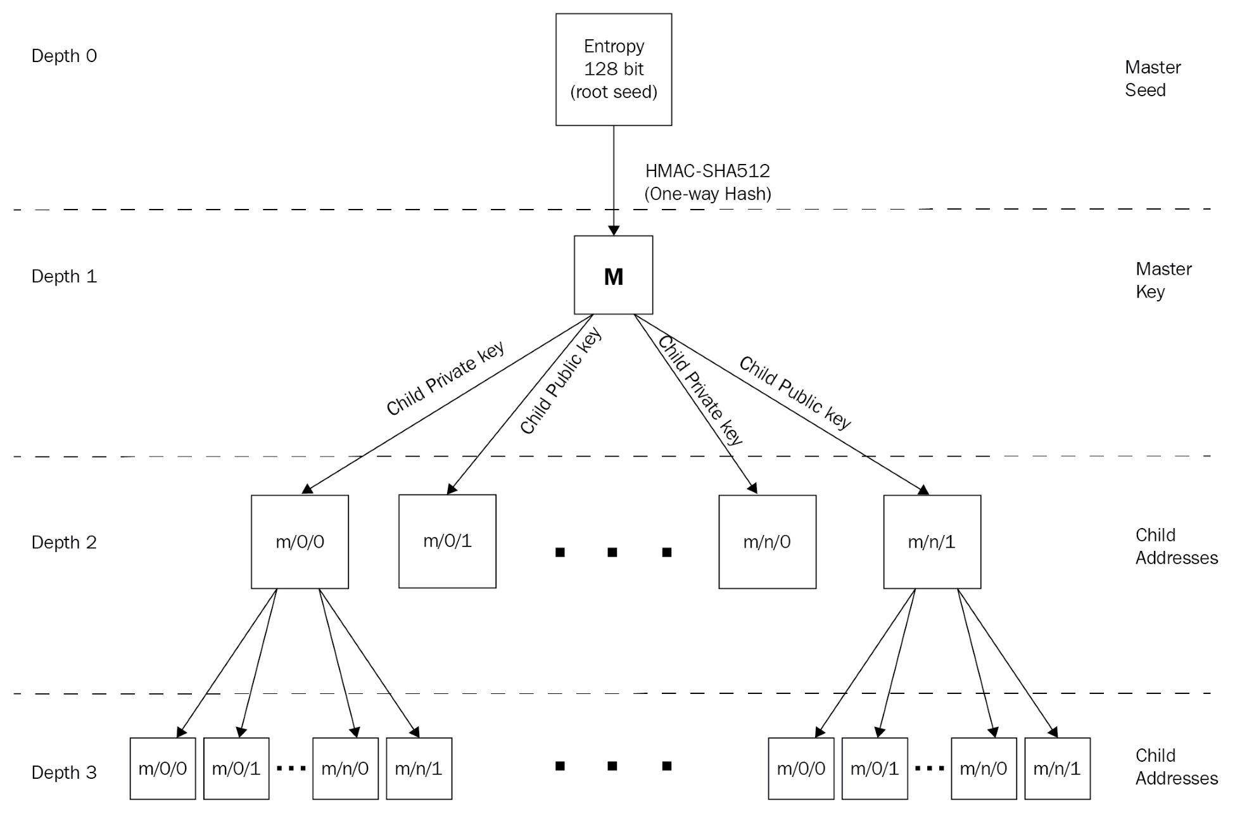

Slide 17
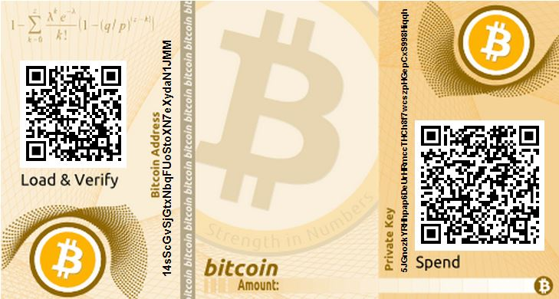
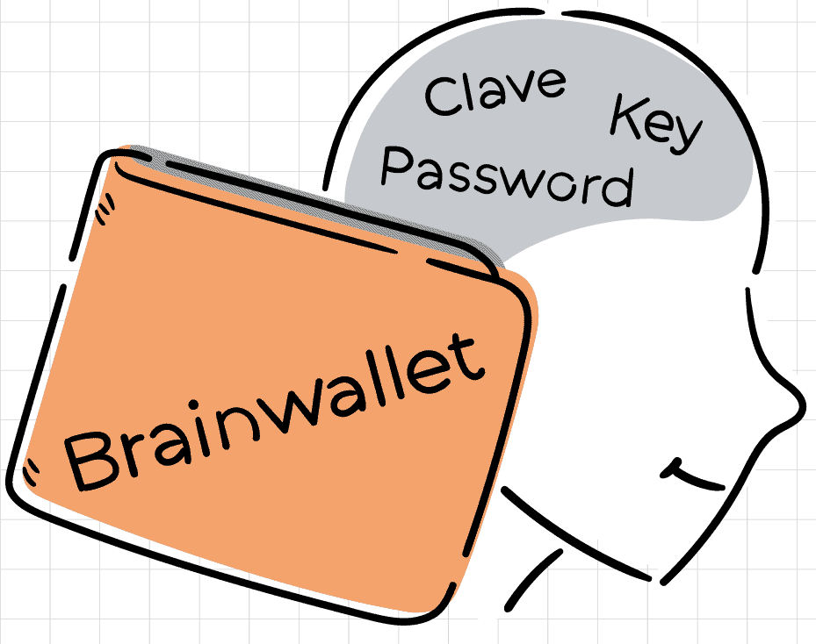
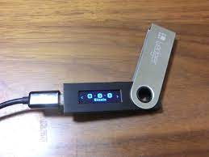
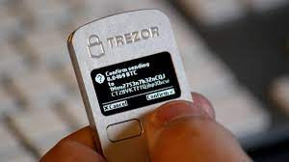
Types of wallets
Brain wallets
The master private key can also be derived from the hashes of passwords that are memorized
This is used to derive the private key
This method is prone to password guessing and brute-force attacks
Paper wallets
paper-based wallet with the required key material printed on it.
Hardware wallets
use a tamper-resistant custom-built device to store keys
Trezor and Ledger wallets (various types) are the most commonly used Bitcoin hardware wallets

Slide 18
Types of wallets
Online wallets
stored entirely online
They provide a web interface to the users to manage their wallets and perform various functions, such as making and receiving payments.
Mobile wallets
It is installed on mobile devices.
perform various functions

Slide 19
Innovation in Bitcoin
Performance is a key issue in bitcoin
Many proposal in recent years improved Bitcoin performance, resulting in
greater transaction speed
increased security
payment standardization
overall performance improvement at the protocol level.
These improvement proposals are usually made in the form of Bitcoin Improvement Proposals (BIPs)

Slide 20
Bitcoin Improvement Proposals
There are three types of BIPs:
Standard BIP:
Used to describe the major changes that have a major impact
for example, block size changes, network protocol changes
Process BIP
It deal with proposing a change in a process that is outside the core Bitcoin protocol
These are implemented only after a consensus among Bitcoin users
Informational BIP:
These are usually used to just advise or record some information
such as design issues

Slide 21

Bitcoin payments
Bitcoin is not recognized as a legal currency in many jurisdictions,
But it is increasingly being accepted as a payment method
Various payment solutions, such as XBT terminal and the 34 Bytes Bitcoin POS terminal, are available commercially.

Slide 22
Bitcoin payments
Various Bitcoin Improvement Proposal (BIP) have been proposed and finalized in order to introduce and standardize Bitcoin payments
BIP70 (secure payment protocol) describes the protocol for secure communication between a merchant and customers
This protocol uses X.509 certificates for authentication and runs on HTTP and HTTPS
There are three messages in this protocol:
PaymentRequest,
Payment
PaymentACK.

Slide 23
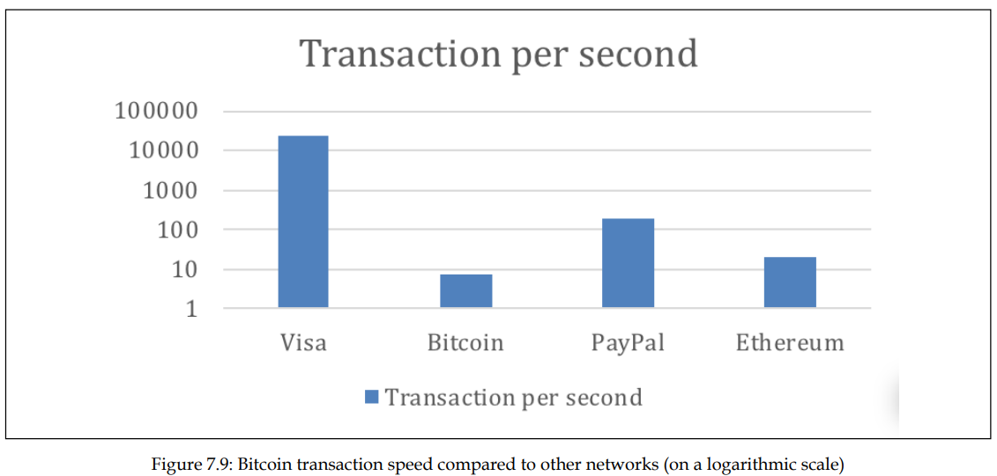
Advanced protocols
The Bitcoin network can only process approximately three to seven transactions per second, which is a tiny number compared to other financial networks.

Slide 24
Segregated Witness (SegWit)
It is a soft fork-based upgrade of the Bitcoin protocol that addresses weaknesses such as throughput and security in the Bitcoin protocol
SegWit was proposed in BIP 141, BIP 143, BIP 144, and BIP 145.
SegWit offers a number of improvements,
Fix for transaction malleability due to the separation of signature data from transactional data
The transactions can be verified without the useless signatures
increased bandwidth efficiency
Reduction in transaction signing and verification times, which results in faster transactions

Slide 25
Segregated Witness (SegWit)
SegWit offers a number of improvements, [Contd...]
A new transaction hashing algorithm for signature verification has been introduced in BIP0143
Script versioning capability, which allows for easier script language upgrades
Increased block size by introducing a weight limit instead of a size limit & the removal of signature data.
An improved address format, also called a "bc1 address," which is encoded using the Bech32 mechanism instead of base58
It has better error detection and correction
This weight is calculated on a per-transaction basis

Slide 26
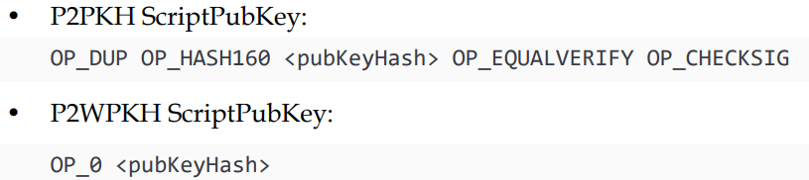
Segregated Witness (SegWit)
There are four types of transactions introduced by SegWit
Pay to Witness Public Key Hash (P2WPKH)
This type of script is similar to the P2PKH
the transaction signature used as a proof of ownership in ScriptSig is moved to a separate structure known as the "witness" of the input.
The ScriptPubKey is modified to a simpler format

Slide 27
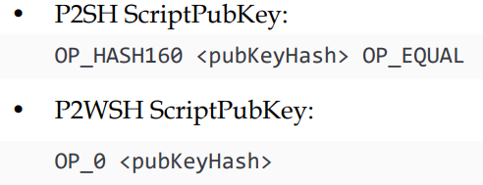
Segregated Witness (SegWit)
Pay to Script Hash - Pay to Witness PubKey Hash (P2SH-P2WPKH):
This is a mechanism made SegWit transactions backward-compatible.
This is made possible by nesting the P2WPKH inside the usual P2SH.
Pay to Witness Script Hash (P2WSH):
This script is similar to legacy P2SH but the signature and redeem script are moved to the separate witness field.
ScriptSig is simply empty
script is identified by a 32-byte SHA-256 hash

Slide 28
Segregated Witness (SegWit)
Pay to Script Hash - Pay to Witness Script Hash (P2SH-P2WSH): Similar to P2SHP2WPKH,
this is a mechanism that allows backward-compatibility with legacy Bitcoin nodes

Slide 29

Bitcoin investment
There are many online exchanges where users can buy and sell Bitcoin.
This is a big business on the internet now and it offers Bitcoin trading, CFDs, spread betting, margin trading, and various other choices.

